Slide 1
Training a Neural Network
Michael Shao

Slide 2
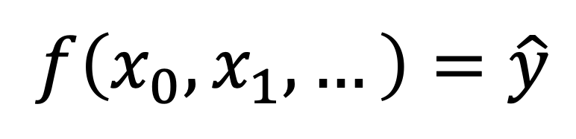
Machine Learning
Looking for the function
$$f\left(x_{0},x_{1},…\right)=\hat{y}$$

Slide 3
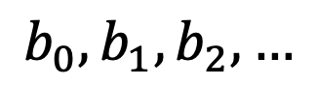
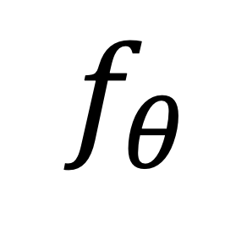
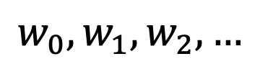
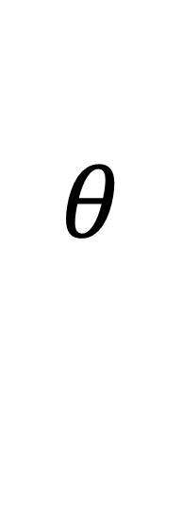

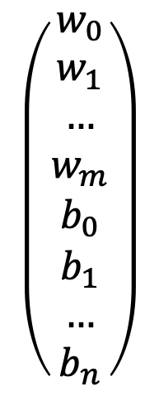
We’ve defined the structure
but what about the parameters?
$$\left(\begin{aligned}w_{0} \\ w_{1} \\ … \\ w_{m} \\ b_{0} \\ b_{1} \\ … \\ b_{n}\end{aligned}\right)$$
$$θ$$
$$w_{0}, w_{1},w_{2},…$$
$$f_{θ}$$
$$f$$
$$b_{0}, b_{1},b_{2},…$$

Slide 4
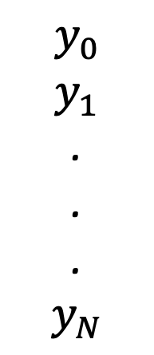
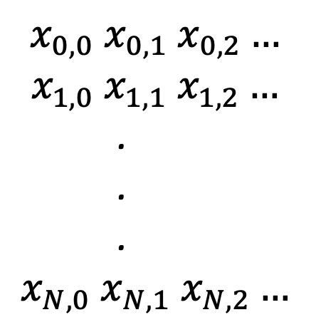


What’s the best 𝜃?
We can evaluate the performance of the model based on how closely the output follows the distribution in the labeled training set.
$$X$$
$$y$$
$$x_{0,0} x_{0,1} x_{0,2}…$$
$$x_{1,0} x_{1,1} x_{1,2}…$$
.
.
.
$$x_{N,0} x_{N,1} x_{N,2}…$$
$$y_{0}$$
$$y_{1}$$
.
.
.
$$y_{N}$$

Slide 5
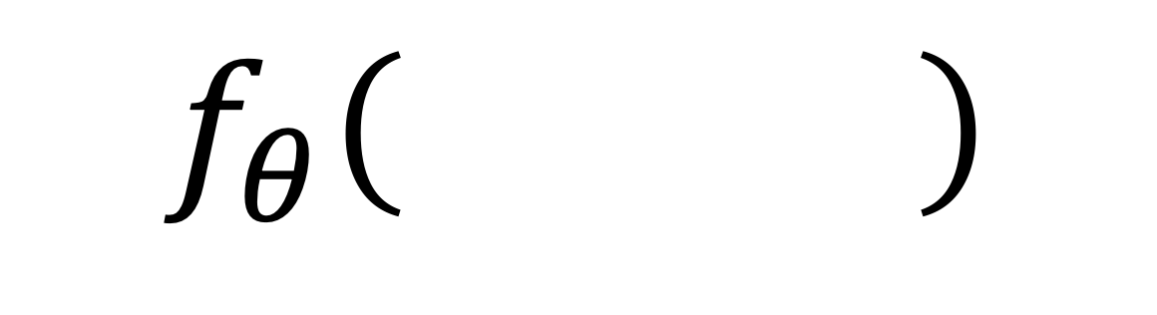
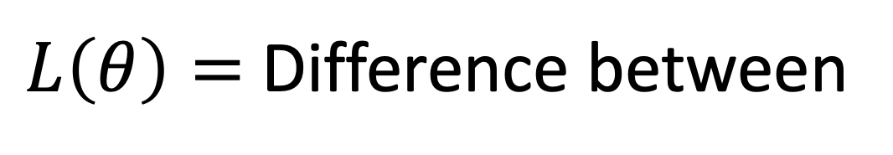


Comparing distributions?
Defining a loss function
$L\left(θ\right)=$ Difference between
$$X$$
$$y$$
$$f_{θ}\left( \right)$$
and

Slide 6
Optimization
Gradient Descent

Slide 7
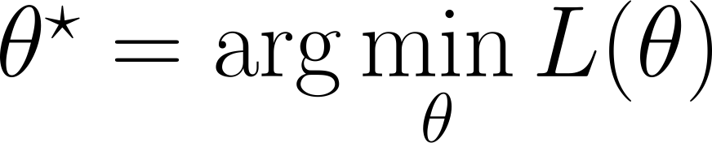
Minimizing the loss function
How do we do this?

Slide 8
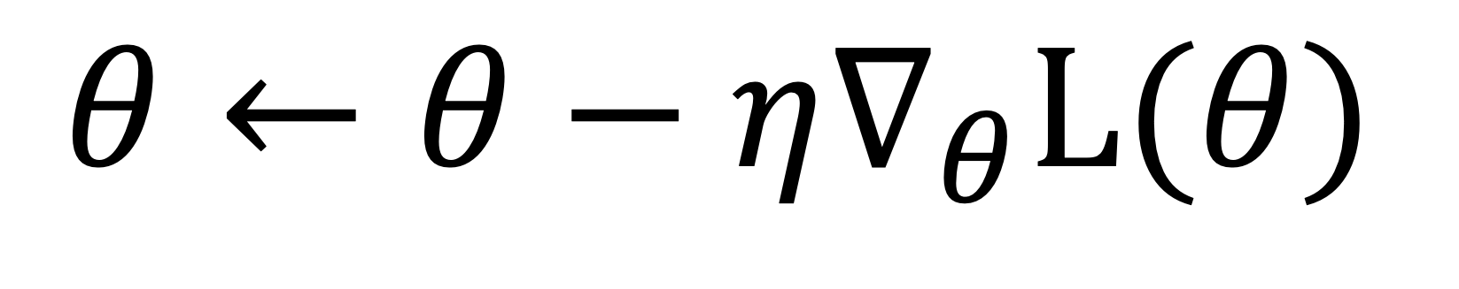
Gradient Descent
Descending a slope:
https://uclaacm.github.io/gradient-descent-visualiser/#playground
$$θ←θ−η∇_{θ}L(θ)$$

Slide 9
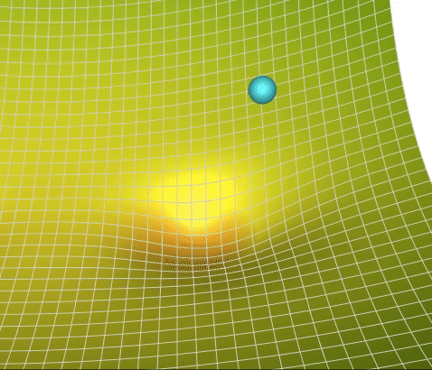
https://towardsdatascience.com/a-visual-explanation-of-gradient-descent-methods-momentum-adagrad-rmsprop-adam-f898b102325c

Slide 10
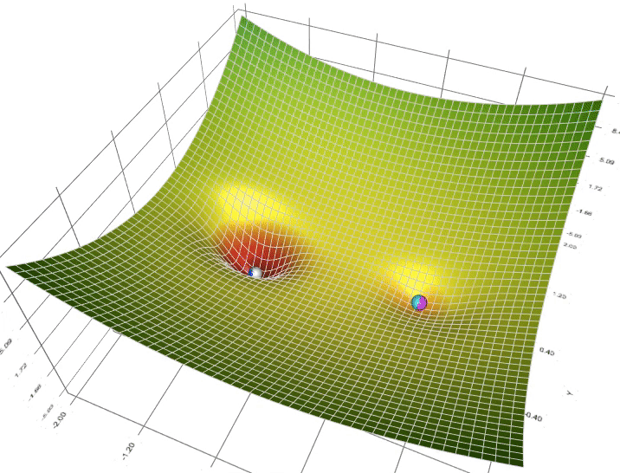
Local Minima
https://towardsdatascience.com/a-visual-explanation-of-gradient-descent-methods-momentum-adagrad-rmsprop-adam-f898b102325c

Slide 11
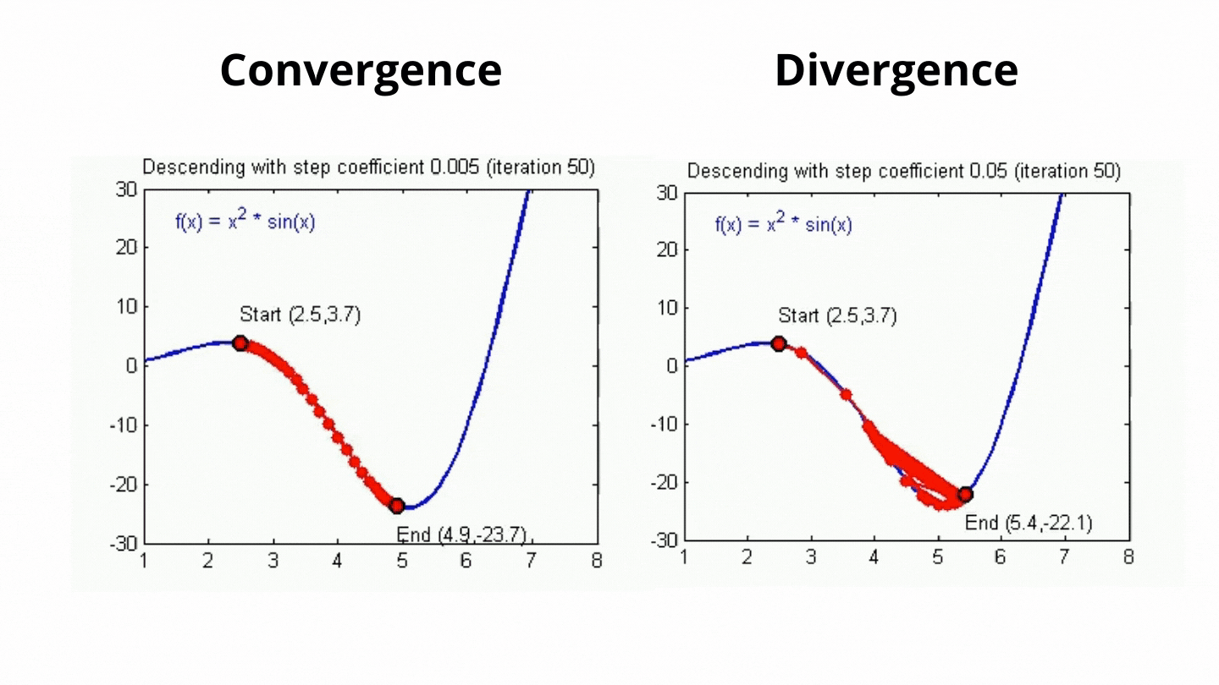
Learning Rate
The learning rate hyperparameter determines how “fast” the machine learns in each step.
https://towardsai.net/p/machine-learning/analysis-of-learning-rate-in-gradient-descent-algorithm-using-python

Slide 12
Step, Batch, Epoch
Split training data randomly into batches based on batch size.
Calculate loss on batch, perform gradient descent = 1 step
Iterate over all batches = 1 epoch

Slide 13
Loss Functions
The Training Criteria

Slide 14
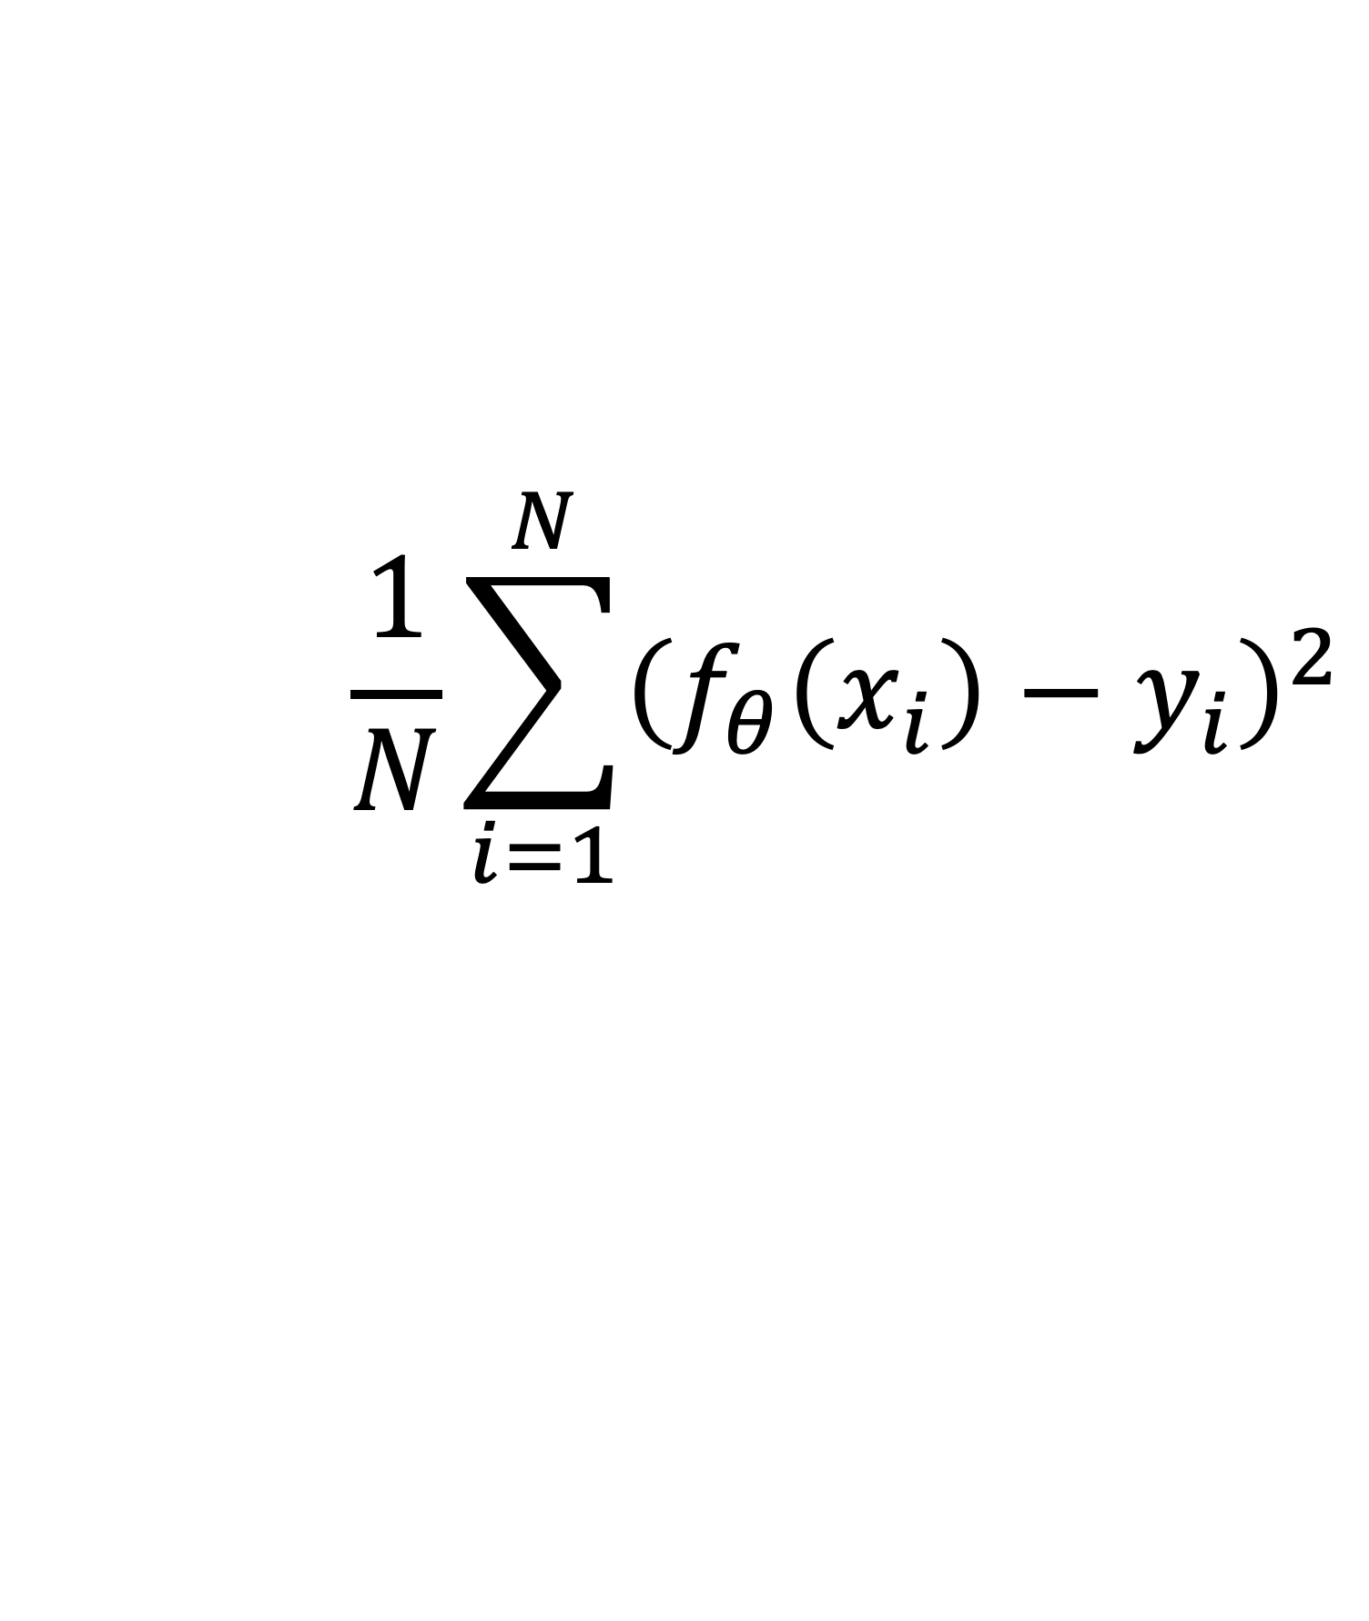
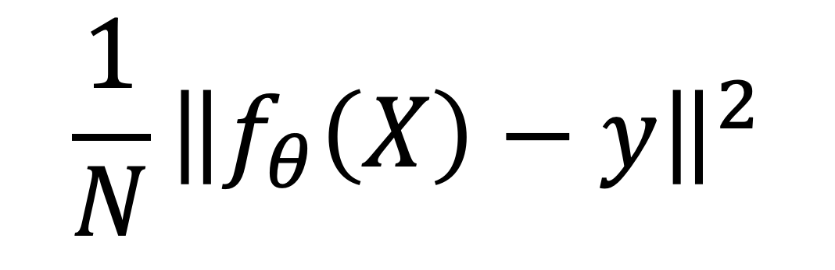
Mean Squared Error Loss
criterion = torch.nn.MSELoss()
$$\frac{1}{N}\sum_{i=1}^{N}{{\left(f_{θ}\left(x_{i}\right)−y_{i}\right)}^{2}}$$
$${\frac{1}{N}\left\|f_{θ}\left(X\right)−y\right\|}^{2}$$

Slide 15

Loss for Classification Tasks?
Number of misclassifications?
Inaccuracy?

Slide 16

What does a classification model output?
$$\left(\begin{aligned}0.2 \\ 1.3 \\ 25.7 \\ −11 \\ 102\end{aligned}\right)$$
0
1
2
3
4
But each output has no “meaning”. Their values are only relative to the others.

Slide 17
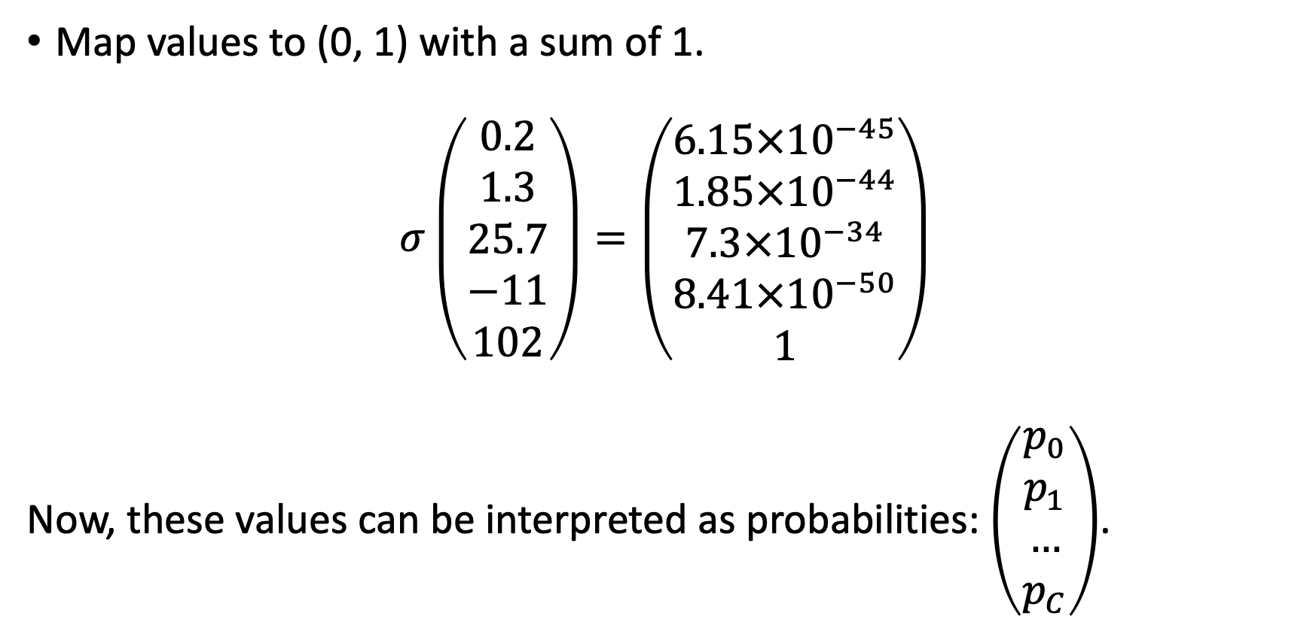
Introducing… Softmax Activation
Map values to (0, 1) with a sum of 1.
$$σ\left(\begin{aligned}0.2 \\ 1.3 \\ 25.7 \\ −11 \\ 102\end{aligned}\right)=\left(\begin{aligned}6.15×{10}^{−45} \\ 1.85×{10}^{−44} \\ 7.3×{10}^{−34} \\ 8.41×{10}^{−50} \\ 1\end{aligned}\right)$$
Now, these values can be interpreted as probabilities: $\left(\begin{aligned}p_{0} \\ p_{1} \\ … \\ p_{C}\end{aligned}\right)$.

Slide 18
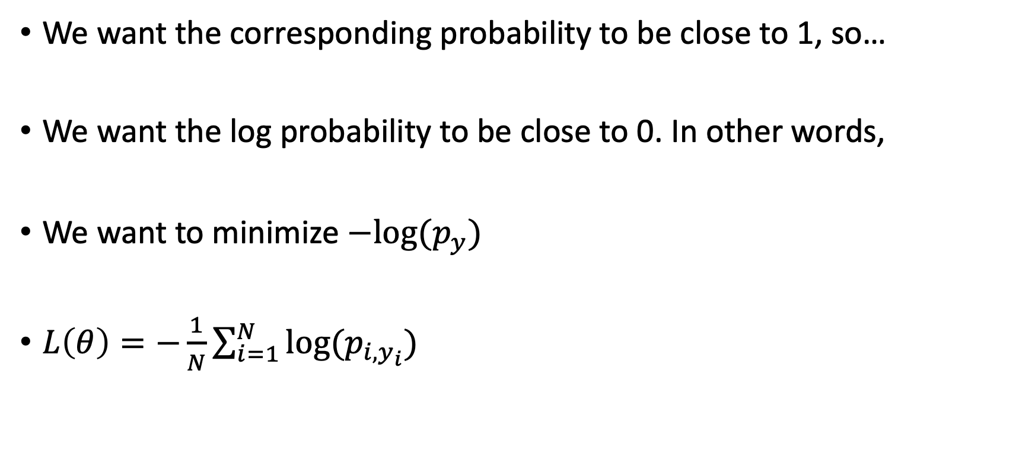
Cross Entropy Loss
We want the corresponding probability to be close to 1, so…
We want the log probability to be close to 0. In other words,
We want to minimize $−log⁡(p_{y})$
$L\left(θ\right)=−\frac{1}{N}\sum_{i=1}^{N}{log⁡(p_{i,y_{i}})}$

Slide 19
Cross Entropy Loss
criterion = torch.nn.CrossEntropyLoss()
criterion = torch.nn.BCELoss() # For Binary CE

Slide 20
Calculating The Gradient
Back Propagation… In very very very simple words

Slide 21
Back Propagation
The gradient is propagated from the last layer all the way back to the first layer.
Keywords: partial derivatives, chain rule
https://www.youtube.com/watch?v=Ilg3gGewQ5U

